Slide 1
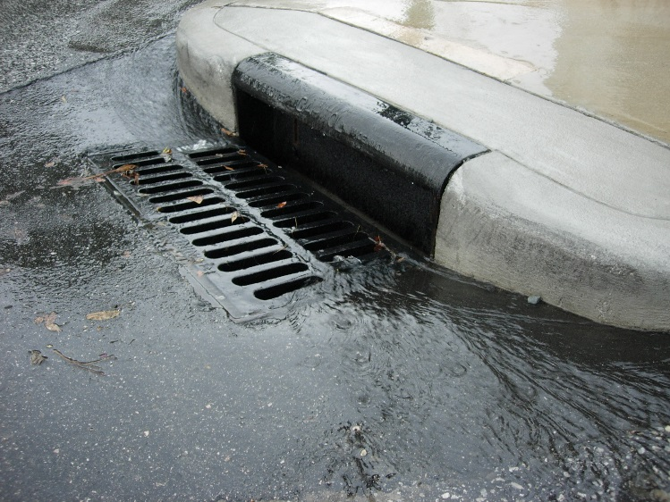
Land Use and Zoning Committee Special Workshop
http://usaservicesfl.com
Flooding and Drainage Regulation
ONE CITY. ONE JACKSONVILLE.

Slide 2
Regulatory Background
2030 Comprehensive Plan
High level policy statements
Provide for specific courses of action to guide day-to-day decision making and are implemented through detailed regulations such as the LDPM and Municipal Code
Examples:
Policy 2.7.1 The City shall continue to define the surface hydrology of the area to determine flood plain vulnerability and sensitivity, and will determine appropriate protection measures.
Policy 1.4.4 The City shall require all development within the 100 year flood plain to be in strict conformance with all applicable federal, State, regional and local development regulations.
Pending comprehensive plan amendment enhances existing floodplain management regulations and addresses associated impacts of sea level rise

Slide 3
Regulatory Background
Land Development Procedures Manual (LDPM)
Comprehensive guide to development
Detailed design standards, methodologies and formulas for drainage design
Development related stormwater runoff must not harm upstream or downstream property
Developers under pre/post development discharge restriction
Engineering solutions such as lot filling, grading, ditches, swales, ponds
Planning and Development Department - November 13, 2017

Slide 4
Regulatory Background
Floodplain Management Ordinance
Chapter 652, Municipal Code
Minimum requirements to safeguard public health, safety and general welfare and to minimize public/private loss due to flooding through regulation of flood hazard areas
Standards intended to manage “100-year flood” or the “1-percent annual chance flood”
Applies to all development partially or wholly in flood hazard area
Flood hazard areas established by 2013 Flood Insurance Study, Flood Insurance Rate Maps (FIRM) and supporting data in the Master Stormwater Management Plan (MSMP)
Planning and Development Department - November 13, 2017

Slide 5
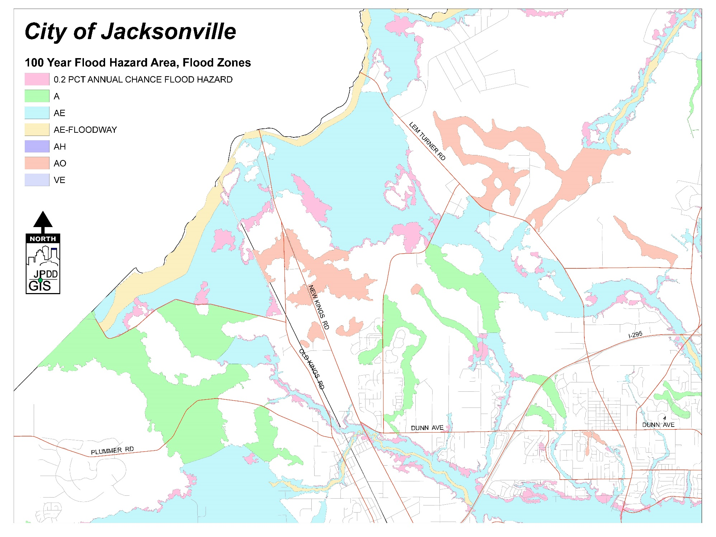
Flood Zone Map
Planning and Development Department - November 13, 2017

Slide 6
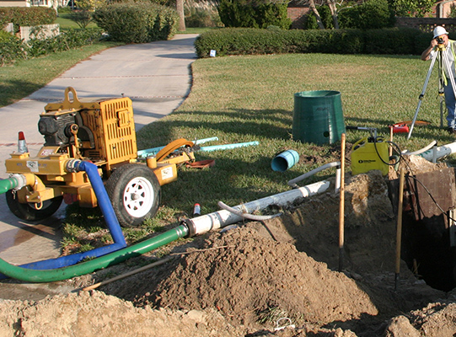
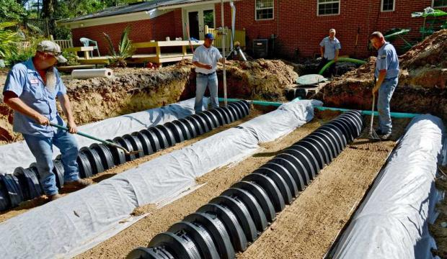
Regulatory Background
Concurrency and Mobility System
Chapter 655, Municipal Code
Includes drainage review component
Drainage level of service (LOS) standards and methodologies compatible with the LDPM
Jea.com
jacksonville.com
Planning and Development Department - November 13, 2017

Slide 7
Roles & Responsibilities in
Design & Permitting
Engineering Professionals Certify that:
All contributing areas accounted for;
On-site collection design accuracy;
Ponds designed per LDPM;
Conveyance methods (pipes/ditches), elevations, calculations for flow characteristics accounted/documented; and
Obtain permits from the SJRWMD and City
Planning and Development Department - Development Services Division:
Verify engineer drainage plan analysis and design;
Acceptable design methodologies and equations per LDPM;
Staff walks final inspection unless developer utilizes private inspector; and
Evaluate concurrency applications for drainage capacity per LOS standards to protect function of the existing drainage system
Planning and Development Department - November 13, 2017

Slide 8
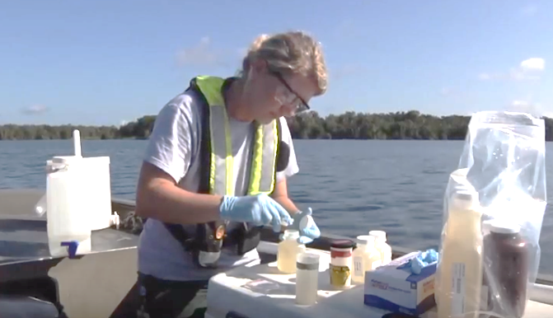
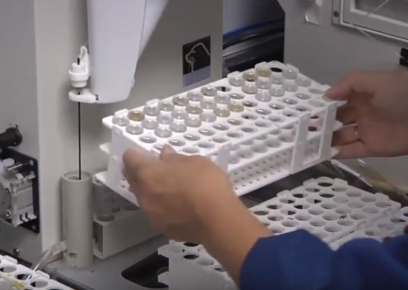
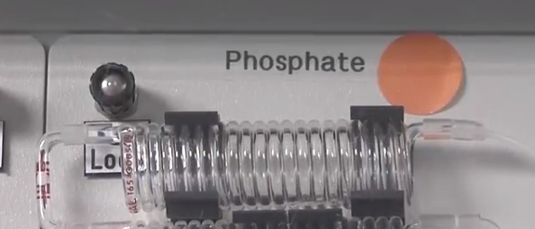
Roles & Responsibilities in Design & Permitting
sjrwmd.com
St. Johns River Water Management District (SJRWMD)
Focused primarily on water quality
Stormwater size and design specifications overlap with City’s drainage requirements except in restricted basins
sjrwmd.com
sjrwmd.com
Planning and Development Department - November 13, 2017

Slide 9
Land Development Procedure Manual (LDPM)
Development Drainage Requirements
Engineering Professional - provides certified data, methodology and engineering solutions that protect adjacent land owners from harm.
Develops Master Drainage Map
Creates lot grading and lot filling plan
Provides soil investigation report
Ensures no obstruction of existing drainage
Accommodates flood zone and flood-prone area storage needs
Ensures capacity for downstream drainage systems
Ensures stormwater runoff does not impact adjacent property
Stormwater management facilities are owned and maintained by a private entity
City is relieved from liability related to stormwater management facilities by execution of a “hold harmless” agreement
Planning and Development Department - November 13, 2017

Slide 10
2030 Comprehensive Plan
High level guiding policy document
Sets out general policy to guide detailed regulations such as:
Level of Service (LOS) standards for concurrency related drainage reviews consistent with LDPM
Tasking the City with defining surface hydrology to determine flood plain vulnerability and appropriate protection measures
Establishing general priorities for protection measures to apply to identified floodplain areas
Pending Ordinance 2017-627
Floodplain Management
Adaptation Action Area (AAA) / Coastal High Hazard Area (CHHA)
Establishes a working group to address implications and potential responses to the effects of coastal flooding within the AAA
Planning and Development Department - November 13, 2017

Slide 11
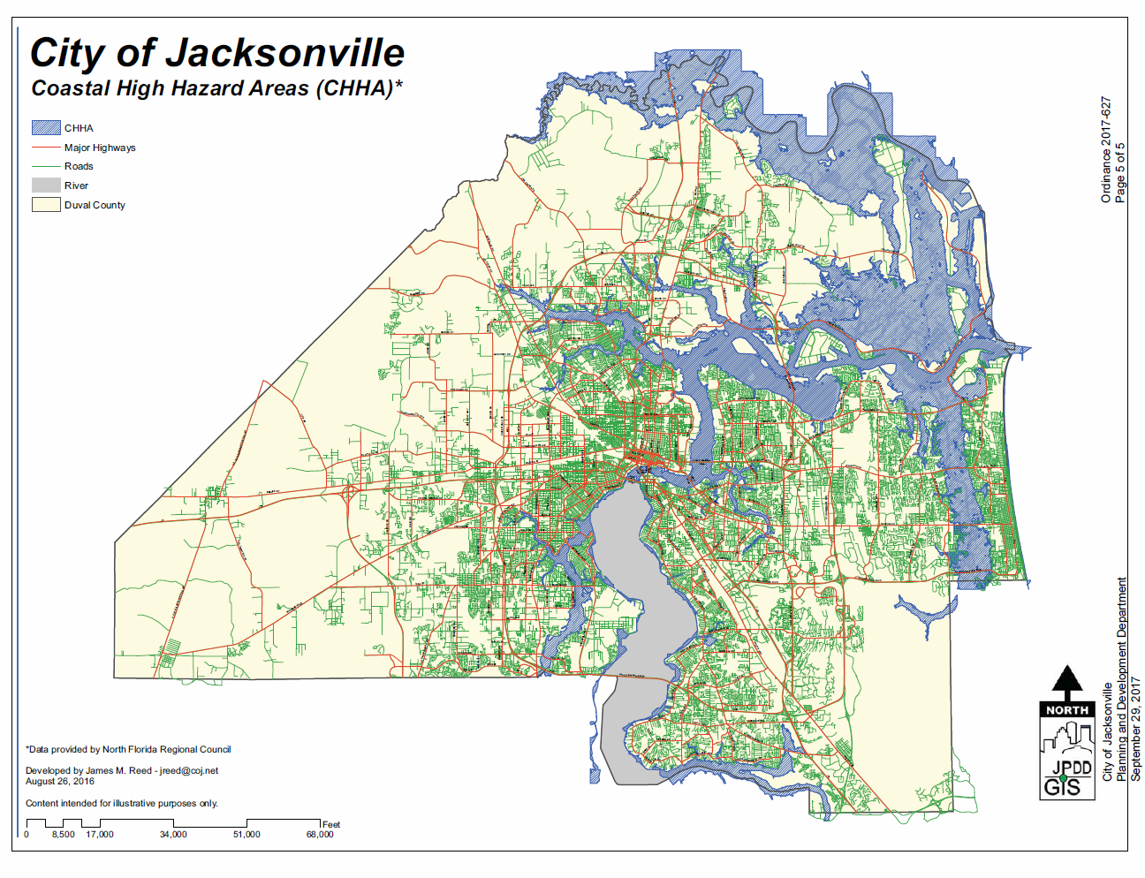
Coastal High Hazard Areas Map
Planning and Development Department - November 13, 2017

Slide 12
Strengths and Weaknesses
Strengths
Effective engineering regulations
2030 Comprehensive Plan policies support regulations
Pending Ordinance 2017-627 supports Floodplain Management Ordinance and initiates discussion of potential impacts of sea level rise
Weaknesses
Private inspection firms report directly to developer
Protections for adjacent properties during development
Infill development regulations and inspections
Private inspectors vs. City inspectors
Private stormwater/flood control infrastructure maintenance
Planning and Development Department - November 13, 2017

Slide 13
Opportunities
Private Inspector approval/reporting structure
Maintenance of drainage plan
Drainage maintenance inspection program and associated enforcement options
Planning and Development Department - November 13, 2017

